Slide 1
Proving Laws using Tabular method

Slide 2
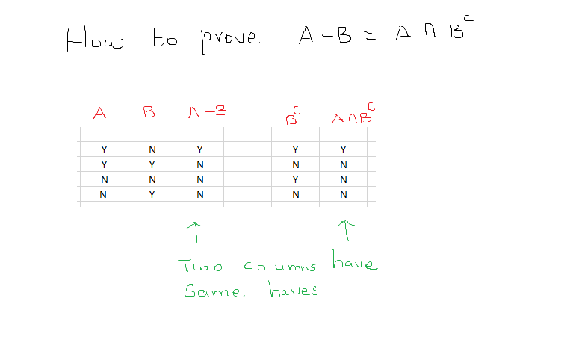
Set Difference Law

Slide 3
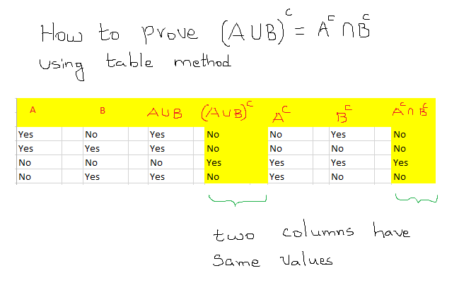
De Morgan's law

Slide 4
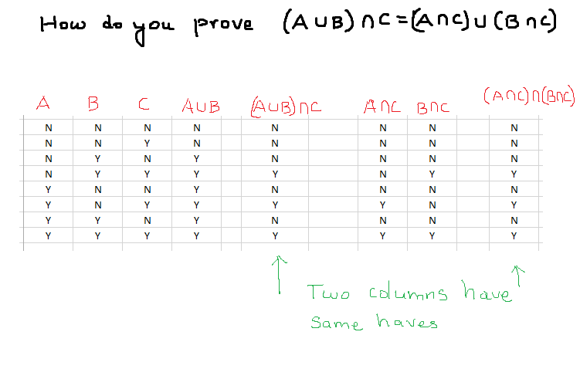
Distributive Law

